Slide 1
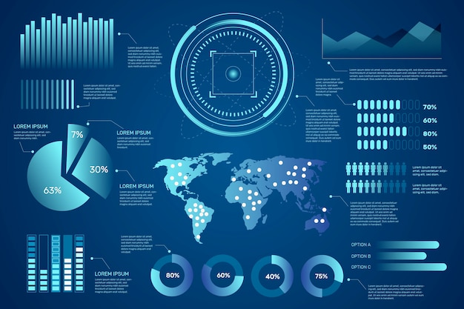
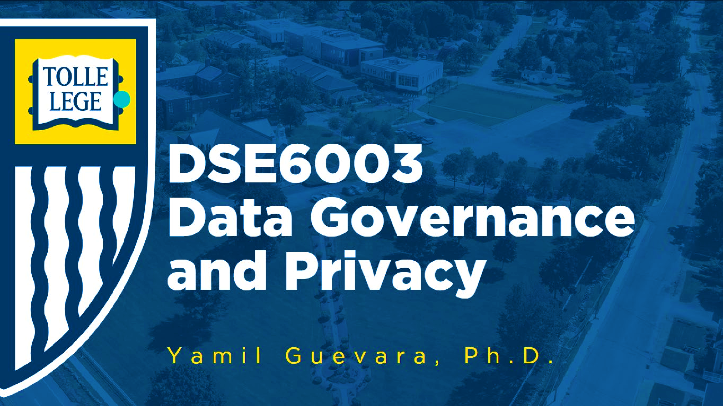
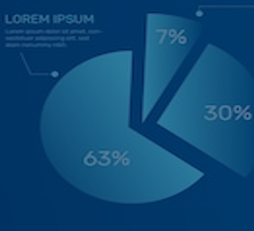
DSA5400
Visual Data Exploration
Module 5: Segmentation and R Shiny
Michael Dupin, Ph.D.

Slide 2
Catch up
Position Paper #2 (past) and
Due Diligence Project (future)

Slide 3
Course Roadmap & Assignments
Week 1 | Week 2 | Week 3 | Week 4 | Week 5 | Week 6 | Week 7 | Week 8
Course learning objectives Data, information, and knowledge Intro to data visualization | Data as a competitive advantage CRISP framework Human perception and cognition | Data types Intro to ML Foundations Grammar of graphics Advanced Visualizing segments | EDA process and due diligence Foundations ggplot2 Advanced Sharing plots | Diagnosis and treatments Special cases: time, space, and clusters | Segmentation R Shiny | Segmentation and profiling Tableau and other dashboards | Course wrap-up Tableau
Introduction | Position Paper #1 | Position Paper #2 | Data Due Diligence Project |  | Segmentation and Profiling Project
Quiz 01 | Quiz 02 | Quiz 03 | Quiz 04 | Quiz 05 | Quiz 06 | Quiz 07 | Quiz 08

Slide 4
(Marketing) Segmentation Project
An Introduction

Slide 5


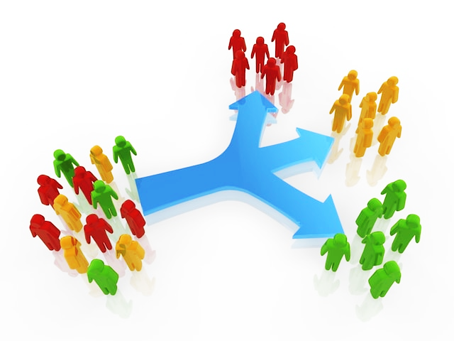
Segmentation and Profiling Project – Overview
Segmentation (final) Project
The overall goal of this project is to conduct a customer segmentation and to profile the resulting customer segments, which entails the identification of similar-within and dissimilar-across groups of customers, highlighting cross- segment retention differences (i.e., long-term customers vs. others).
There are numerous ways of identifying distinct customer segments – e.g., customers may be grouped based on type and volume of past purchases, demographic similarities or preferences, behaviors, needs and attitudes, etc. Furthermore, depending on which base of groupings are selected, and what descriptive characteristics are chosen, the resultant structure and insights from the customer base will be different based on the different selection of driver variables and approaches. Selection of a segmentation approach also depend on specific business objectives or strategies.

Slide 6
Segmentation and Profiling Project – Overview
Assume that you are a marketing analytics manager for a telecommunications company and that you have been tasked with developing customer segmentation that can support effective, and economically sound, customer retention efforts.
To accomplish that goal, you need to take the following data analytical steps:
Carefully review all available data (i.e., the contents of Customer Database), paying particular attention to distinct data types (e.g., product purchases, demographics, etc.), and identify specific variables you would like to use (more than three, less than all) as the basis of your segmentation analysis – make sure to also consider any new variables or indicators you might have previously (Data Due Diligence Project) created, or consider creating new variables now it is important to be able to justify your choice(s)
Review the available clustering techniques and select two (2) distinct techniques – justify your choices (i.e., why those techniques and not others)
Segment your customer base using the two techniques you selected (above)
Evaluate the practical efficacy of your segmentation solutions – conduct side-by-side comparison of the two sets of results, and select the solution that you would recommend being used; make sure to clearly justify your reasoning
Using the solution, you chose above, group all customers into the created segments
Provide a detailed overview (i.e., the number of segments, cross-segment differences, segment- specific profiles, etc.) of the selected segmentation results, expressly differentiating between ‘high’ and ‘low’ retention segments; make sure to provide sound justification for why you consider some segments to be ‘high retention’ while others to be ‘low retention’. Be quantitative when you can.
You may use R to perform the segmentation work, but Tableau must be used to create visualizations

Slide 7
Segmentation and Profiling Project – Overview
Assume that you are a marketing analytics manager for a telecommunications company and that you have been tasked with developing customer segmentation that can support effective, and economically sound, customer retention efforts.
To accomplish that goal, you need to take the following data analytical steps:
Carefully review all available data (i.e., the contents of Customer Database), paying particular attention to distinct data types (e.g., product purchases, demographics, etc.), and identify specific variables you would like to use (more than three, less than all) as the basis of your segmentation analysis – make sure to also consider any new variables or indicators you might have previously (Data Due Diligence Project) created, or consider creating new variables now it is important to be able to justify your choice(s)
Review the available clustering techniques and select two (2) distinct techniques – justify your choices (i.e., why those techniques and not others)
Segment your customer base using the two techniques you selected (above)
Evaluate the practical efficacy of your segmentation solutions – conduct side-by-side comparison of the two sets of results, and select the solution that you would recommend being used; make sure to clearly justify your reasoning
Using the solution, you chose above, group all customers into the created segments
Provide a detailed overview (i.e., the number of segments, cross-segment differences, segment- specific profiles, etc.) of the selected segmentation results, expressly differentiating between ‘high’ and ‘low’ retention segments; make sure to provide sound justification for why you consider some segments to be ‘high retention’ while others to be ‘low retention’. Be quantitative when you can.
You may use R to perform the segmentation work, but Tableau must be used to create visualizations

Slide 8
Segmentation and Profiling Project – Overview
Content
Summary of the Findings: 2-3-page of key findings and recommendations (at the front of your report)
A detailed technical section including (7-10 pages):
Description of the methodology you used to create and select the specific segmentation solution.
Detailed findings (i.e., detailed customer profiles of individual segments)
Depictions of the individual customer segments/profiles created in Tableau
Appendix: Any additional details that you found worthwhile but did not include in other sections.
Format
Length: No more than 10 single-spaced pages (excluding any appendices, title pages, etc)
Use Calibri, 10-pt font throughout.
Use clear headings, sections, bullets, etc as appropriate.
Small blocks of code can be included in the appendix if they improve clarity. Do not include large blocks of code in your report
Output tables should be cleanly formatted and easy to read. Do not copy and paste directly from console output.
Plots from Tableau can be added to the report through screenshots or image exports.
Format: PDF'ed MS Word.

Slide 9
Segmentation
Overview

Slide 10

What Is (Marketing) Segmentation?
Segmentation is the analytic activity of dividing a heterogeneous customer or prospect base into homogeneous groups against which differentiated - and more relevant and impactful - marketing strategies and tactics can be developed and deployed to increase revenue, profitability, and market share
How would you segment these images/people?
Sex/Gender: Grouping by the apparent gender of the individuals.
Age Group: Categorizing by apparent age brackets
Ethnicity/Race: Sorting based on apparent ethnic or racial backgrounds.
Hairstyle: short, long, bald, bearded, etc.
Hair Color: Sorting by natural or dyed hair color such as blonde, brunette, red, black, or gray/white.
Facial Expression: Grouping by facial expressions such as smiling, laughing, neutral, serious, or frowning.
Emotion: Emotion they appear to be expressing—joy, seriousness, contemplation, surprise, etc.
Attire: Sorting them by the type of attire they are wearing—casual, formal, work attire, or artistic/performer's costume.
Accessories: Based on visible accessories, such as glasses, hats, or jewelry.
Activity: Some individuals are engaged in specific activities like playing an instrument, singing, exercising, or wearing professional attire (like a cowboy hat), indicating a possible occupation.
Contextual Elements: Significant props or elements that tell a story, like musical instruments, sports equipment, art supplies, or technological devices.
Solo vs. Grouped Individuals: Some images may feature more than one person, solitary individuals versus pairs or groups.
Indoor vs. Outdoor: those who are photographed indoors versus outdoors.
Candid vs. Posed: Sorting those who appear to be in a candid shot versus those who are clearly posing for the camera.
Portrait Orientation: Some portraits are close-ups, while others show more of the body or background
Background: Type of background in their picture—indoor, outdoor, colored, natural scenes, etc.
Color Scheme: Dominant colors or the overall color tone of the photograph, like cool or warm tones.
Quality of Image: Quality and clarity of the image—high-definition, grainy, or overexposed photos.

Slide 11
An Effective Segmentation Solution Has Various Components
Marketing Example
Value
Lifecycle
Product
Clustering
Engagement
Clustering
Demographic
Attitudinal
Who are the Best customers & what differentiates them from the Rest?
Which customers should get more
investment than others?
Which new customers could become Best customers? Which customers should one grow or retain or reactivate?
What products or services should we cross-sell or up- sell?
Which channels may be most appropriate in interacting with customers?
Do demographics | Do attitudes
influence channel | influence channel
or product or | or product or
service choice? If | service choice?
so, which segments | Why do people do
are appropriate for | what they do?
the brand? | What are the
 | opportunity
 | market segments?
Copyright © Epsilon 2017 Epsilon Data Management, LLC. All rights reserved.
Integrated solution to improve customer experience and proactively manage the customer journey – marketing programs with customer centricity in mind
12

Slide 12

Segmentation Methodology
Rules based
Create business rules or criteria to define identify and distinct groups, e.g. recency, frequency, monetary (RFM)
Modeling based – Unsupervised v Supervised
No idea what I’m looking for…
I know what I’m looking for…
No dependent variable
Don’t know how many unique segments there may be.
Let data drive segmentation solution
Common methodology
includes
Factor-Cluster Analysis
Latent Class Analysis
K-means clustering
You have a dependent variable and know what groups you want to classify (e.g., churn vs. stay)
You feed data into an analysis to identify what are significant variables differentiate the groups
Common methodology includes
Decision tree classification
method (CHAID, CART)
Copyright © Epsilon 2017 Epsilon Data Management, LLC. All rights reserved.
Un- Supervised
Supervised
8

Slide 13
Unsupervised Segmentation Process
Segment Identification
5
Design and Planning
Confirm objectives
Refine themes that will
drive solution
Key hypotheses
Select sets of candidate driver variables
Optimal segment solution
# of segments?
1
Final segment solutions
Segmentation Analytics:
Data Preparation
Factor / Cluster analysis
Latent class analysis
Create segment solutions (iterative process)
Review and finalize solutions
Describe segments
Size Needs / Attitudes
Behaviors / Competitive Product usage
Key firmographics or demographics
4
Profile & Review Solutions
Create profiles for top
few solutions
How many segments?
Are these segments real; do they resonate?
Are they different – needs / demos / product
usage / behaviors /
patient types
2
3
Data Preparation &
Preliminary Analysis
Factor analysis
Variable transformations
Create indices and measures
Examine correlations
Multivariate Analysis
Latent class analysis*
Submit drivers
Choose initial number of segments to model
(3 – 7); Change drivers
Examine model fit & p- values; other statistics
Preliminary profiles
Choose solutions for
deeper analysis
Iterate multiple solutions– w. different candidate variables
* Latent class analysis is shown here; Other machine learning approaches can also be used

Slide 14
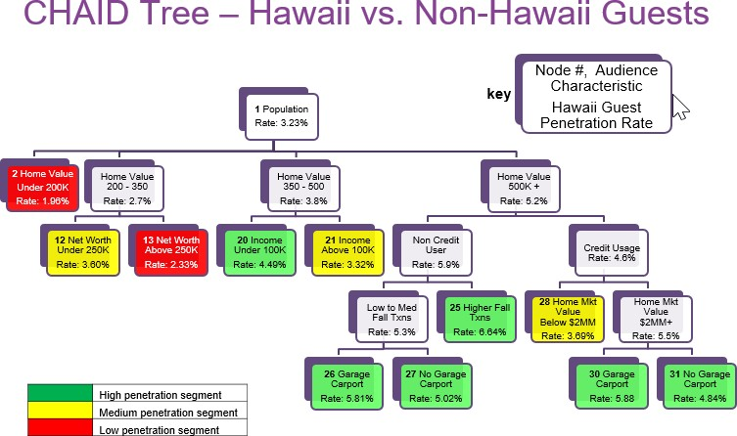
Supervised Segmentation Process
5
1
Final segment solutions
Design and Planning
Confirm objectives
Refine themes that will drive solution
Key hypotheses
Select sets of candidate driver variables
What segment groups we want to understand
Decision Tree Model Example
4
Profile & Review
Solutions
Create profiles for top few nodes
Describe profile that describes segments with the highest
2
3
Data Preparation & Preliminary Analysis
Limited
Candidate segmentation variables typically don’t need to be transformed or treated
3
Multivariate Analysis
Decision Tree Classification model (CHAID or CART)
Multinomial logistic regression for segment groups > 2
Review results and tweak input variable list, # of minimum counts in each decision tree node

Slide 15

Rule Based Segmentation
RFM Segment Example
5
1
Final segment solutions
Design and Planning
Confirm objectives
Refine themes that will drive solution
Key hypotheses
Select sets of candidate driver variables
What segment groups we want to understand
High
$
Monetary Value
(how much do they usually spend?)
$
$
Low
Low
Ancient
4
High
Recency
(When was the last time they shopped?)
Profile & Review
Solutions
Frequency
How often do they shop?
Recent
2
3
3
Data Preparation & Preliminary Analysis
Limited
Select data attributes you want to define the segments
3
Quantify and review segment size and profile
Tweak segment
definition if needed
Finalize
Develop Segmentation Definition
Perform data due
diligence and statistical analysis
Based on results (e.g.,
univariate analysis, distribution, cross- tabulation, etc.) create segment definition
Recency
Value Level | Definition | Count | % | Average
High | <6 months | 58,279 | 47.32% | 2.34
Medium | month 6 - 24 | 46,025 | 37.37% | 12.49
Low | >24 months | 18,862 | 15.31% | 47.64
Monetary
 | Count | Average | % of Revenue
Top 30% | 34,146 | $3,128.60 | 72.97%
Bottom 70% | 79,675 | $496.76 | 27.03%
Frequency
Value Level | Definition | Count | % of Count | Average | Total Orders | % of Orders
High | 10 or more orders | 32,435 | 26.33% | 20.16 | 653,823 | 61.45%
Medium | 6 to 9 orders | 34,672 | 28.15% | 8.18 | 283,607 | 26.65%
Low | less than 6 orders | 56,059 | 45.51% | 2.71 | 126,600 | 11.90%

Slide 16
Segmentation Best Practices
Your segments should be:
Manageable
Number of segments are reasonable (typically more than 2 and less than 10)
Scalable
Segments have large enough a N to be representative and scalable
Identifiable
Segments are intuitive and a qualification (Person for market research) a can be assigned to each
Actionable
Segments are intuitive and can be acted upon
Copyright © Epsilon 2017 Epsilon Data Management, LLC. All rights reserved.
Stable
The segments are not likely to change significantly over time (also people may jump from one to the other)
13

Slide 17
Segmentation Outputs - Examples
Position Paper #2 (past) and
Due Diligence Project (future)

Slide 18
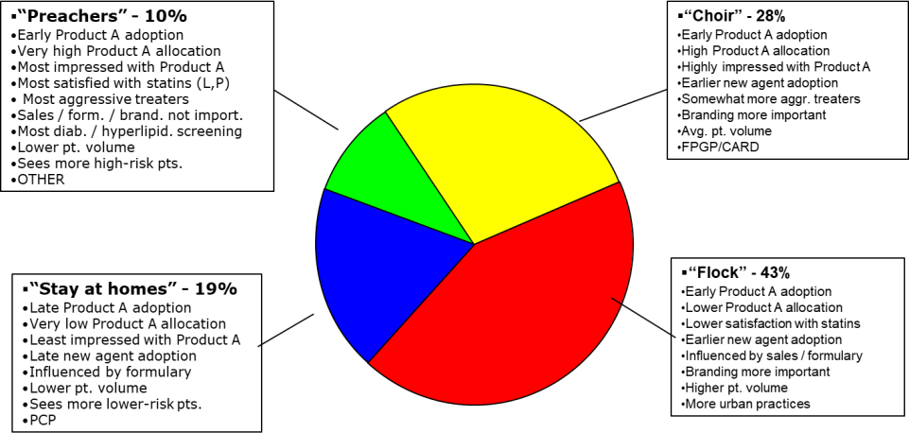
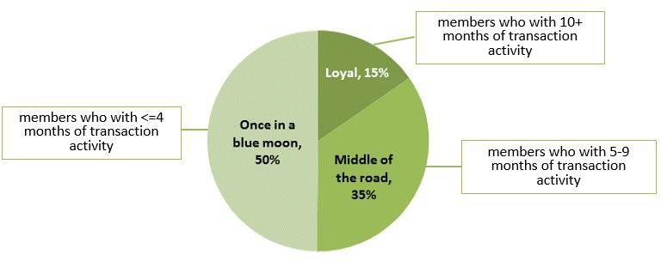
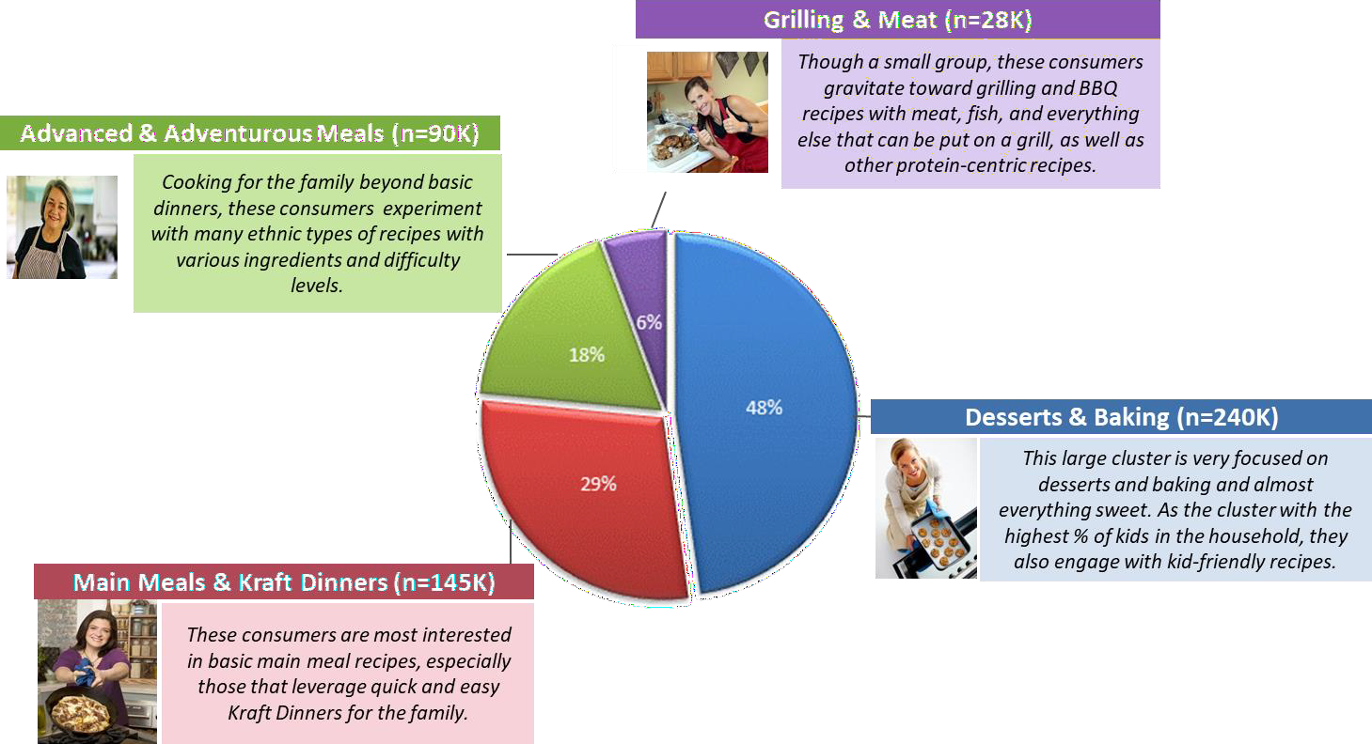
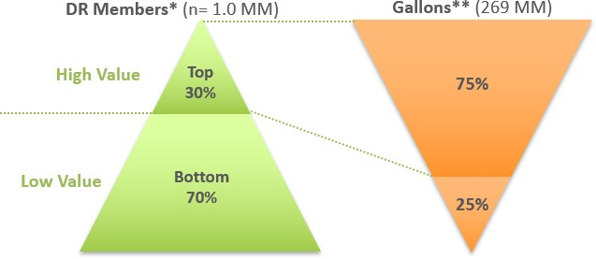
Summarize the Segments that Are Identified

Slide 19
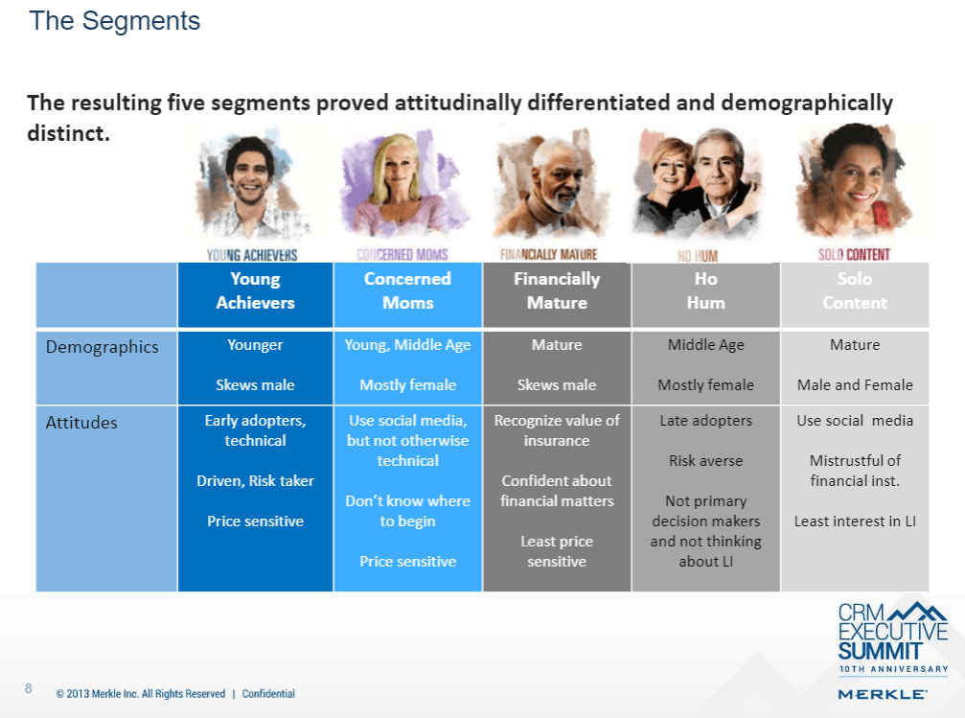
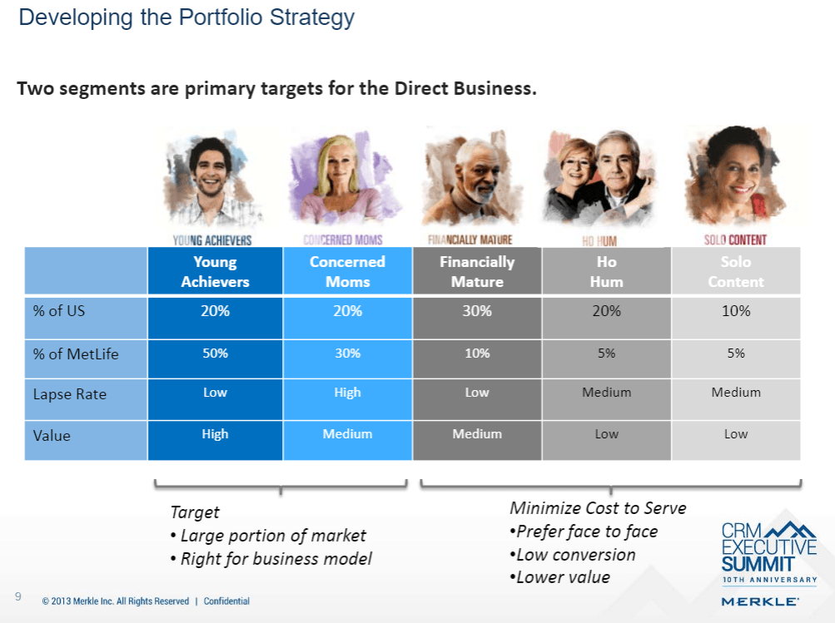
Create Segment Summary

Slide 20

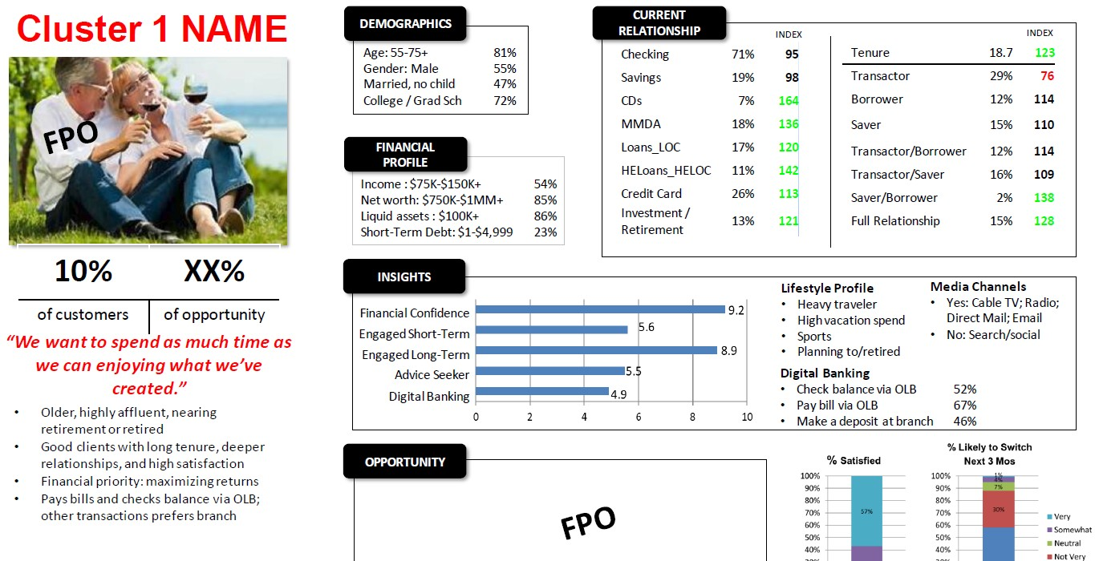
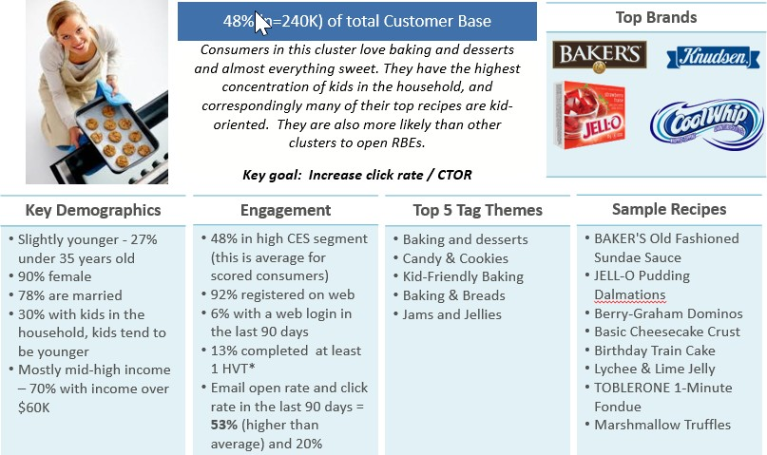
Detailed Segment Profile Examples
Detailed profiling and analysis of segments will provide a deep understanding of the product and
service priorities, needs and attitudes of the segments identified.
Story telling!

Slide 21
R Shiny and Tableau Parameters
Interactive Dashboarding With R and Tableau

Slide 22
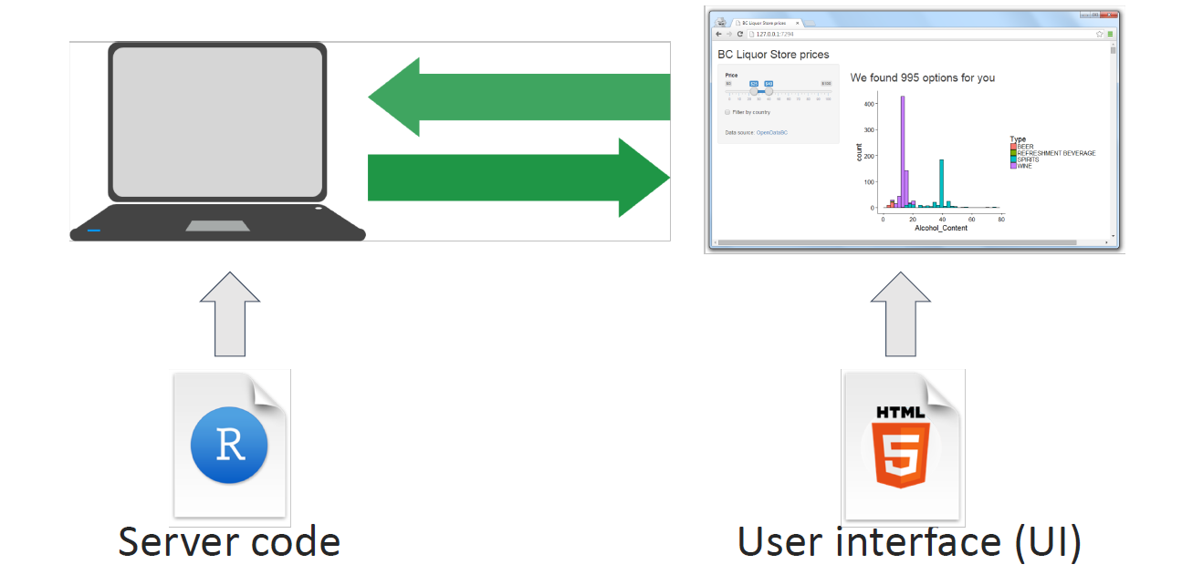
Shiny
Shiny is a package that create a webpage that can receive inputs and take actions to create different outputs.
A Shiny project includes
UI - user interface
Server - R code that runs on the back end
App - connecting the UI and the server
library(shiny)
ui <- fluidPage(
"Page Title"
)
server <- function(input, output, session) {
}
shinyApp(ui, server)
13

Slide 23
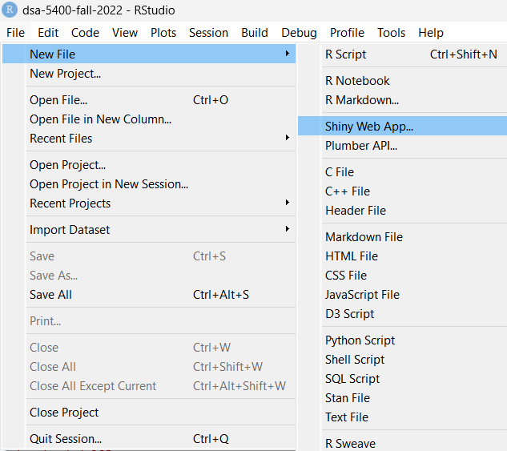

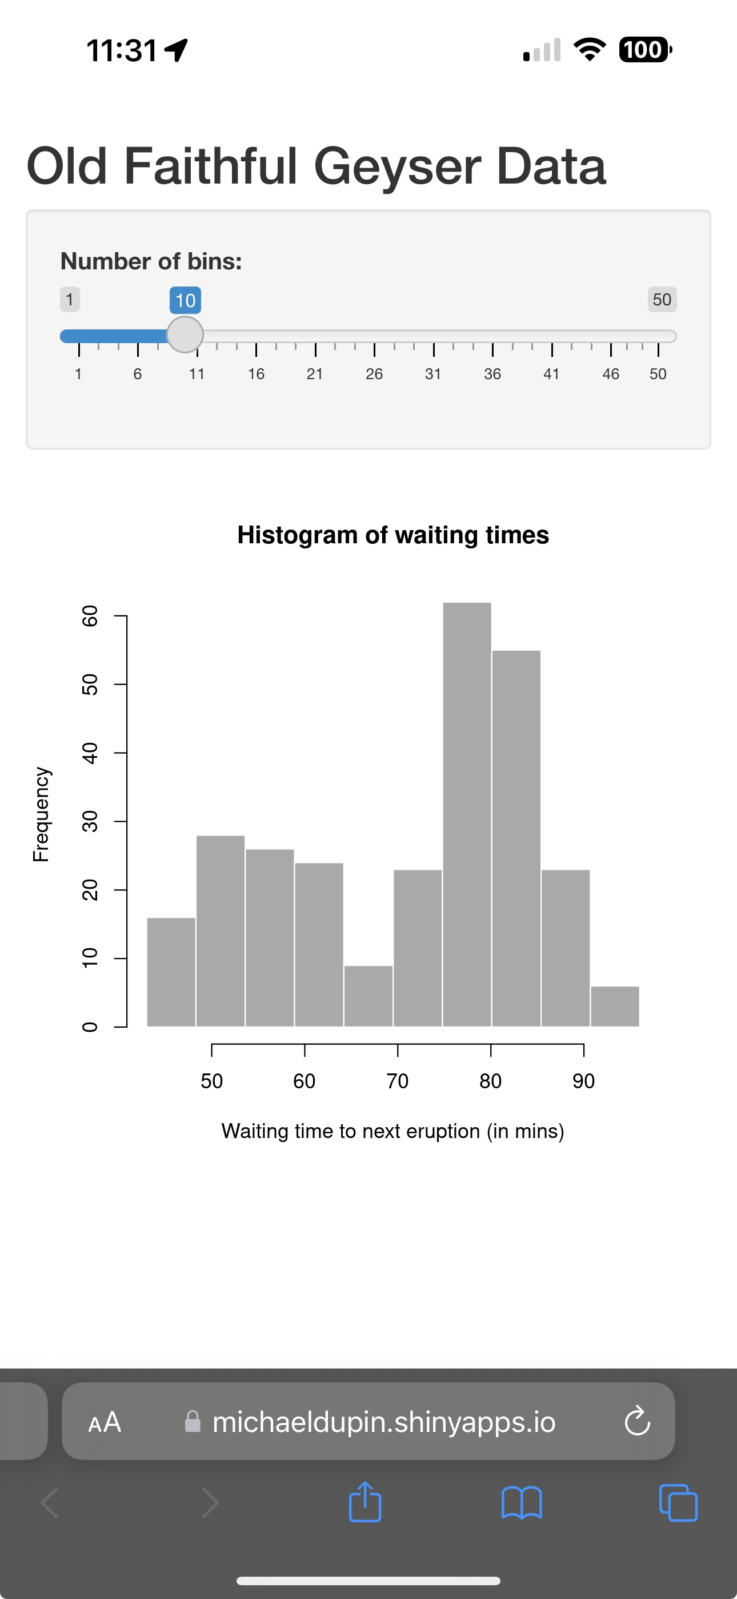
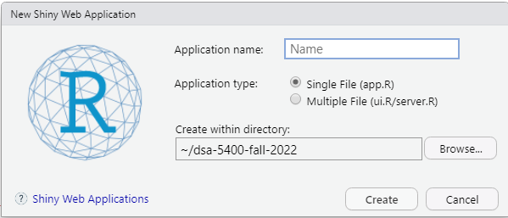
Shiny: Getting Started
Setting up a Shiny Web App
You can deploy on: shinyapps.io
(accounts with small uses are FREE)
My own: Old Faithful Geyser Data (shinyapps.io)
(link: https://michaeldupin.shinyapps.io/In_class_test/ )
13

Slide 24
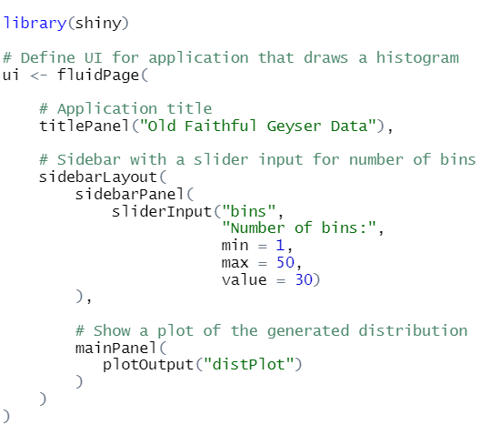
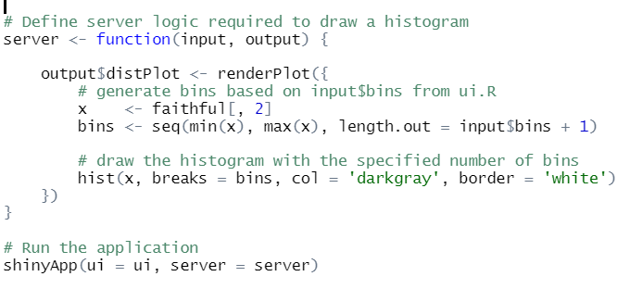
First Example - Old Faithful
FluidPage
Server
FluidPage describes the user interface:
Title: “Old Faithful Geyser Data”
Layout with:
Slider input for number of bins
Plot of histogram
Server covers any computation or updating
The plot rendering on the change of bins
13

Slide 25
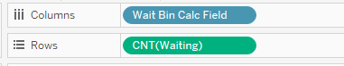
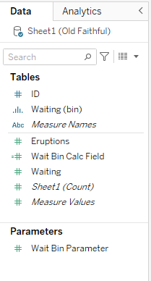
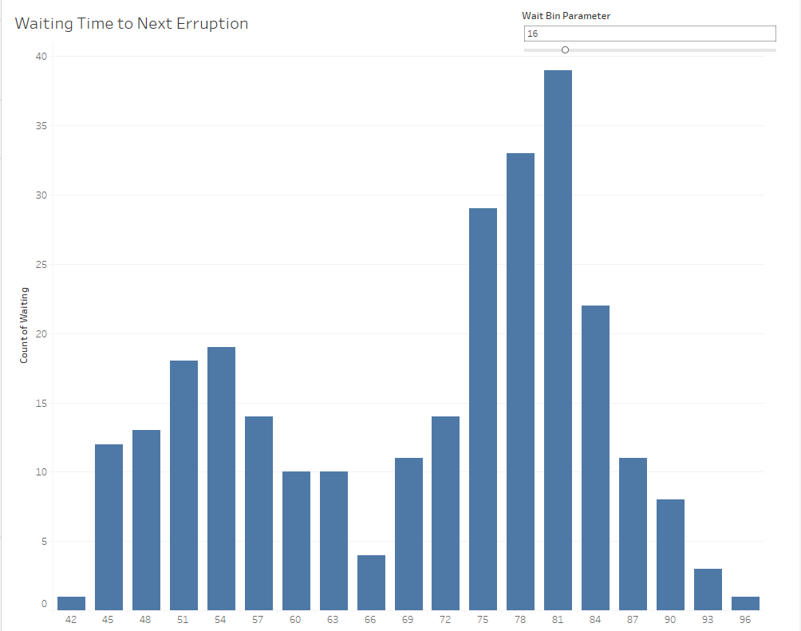
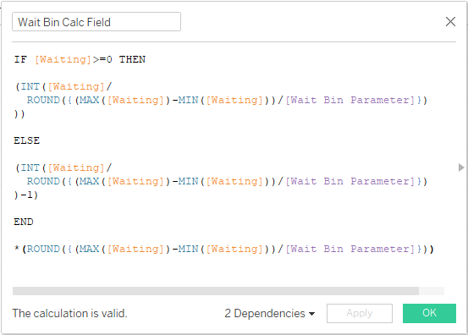
Introduction to Parameters In Tableau
Parameters allows the user of the dashboard to have direct inputs into the Dashboard
The user interacts with the parameter just like with filters…
Parameters are most often used in conjunction with calculated fields:

Slide 26
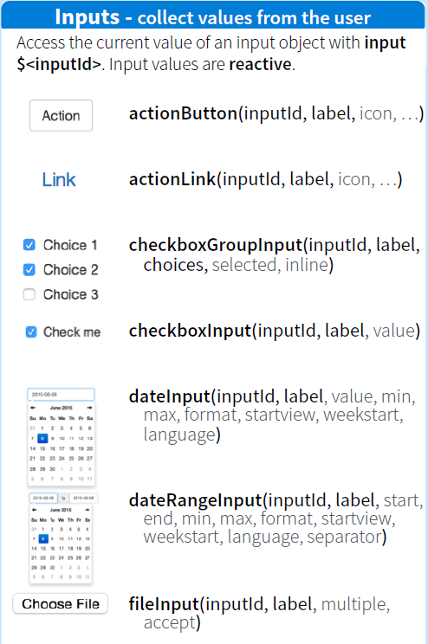
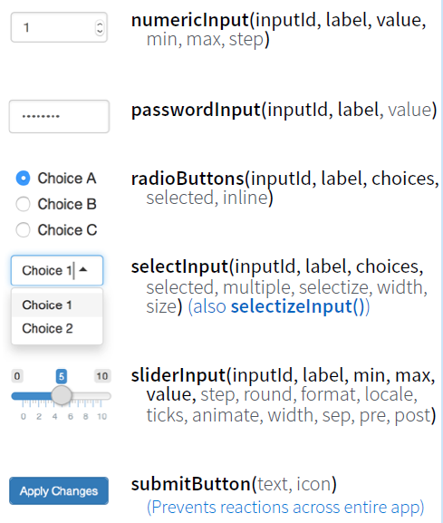
Input and Outputs in UI Code
Inputs - user specified items
13

Slide 27
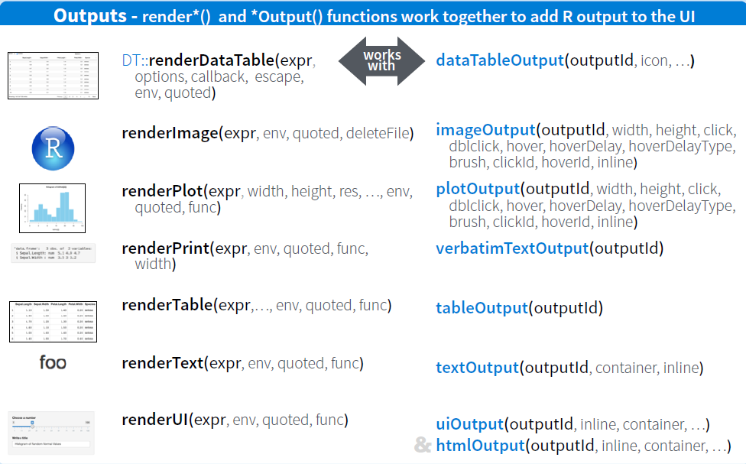
Input and Outputs in UI Code
Outputs – Text and Visualizations
13

Slide 28
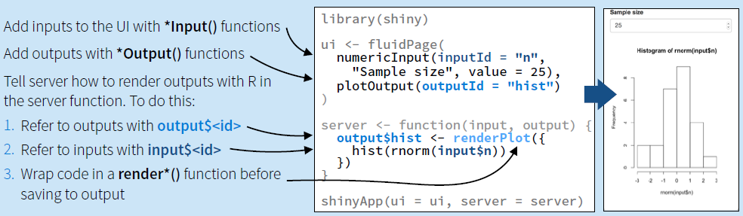
Links between Inputs and Outputs (UI and Server)
Named ids to keep track of input and output items:
13

Slide 29
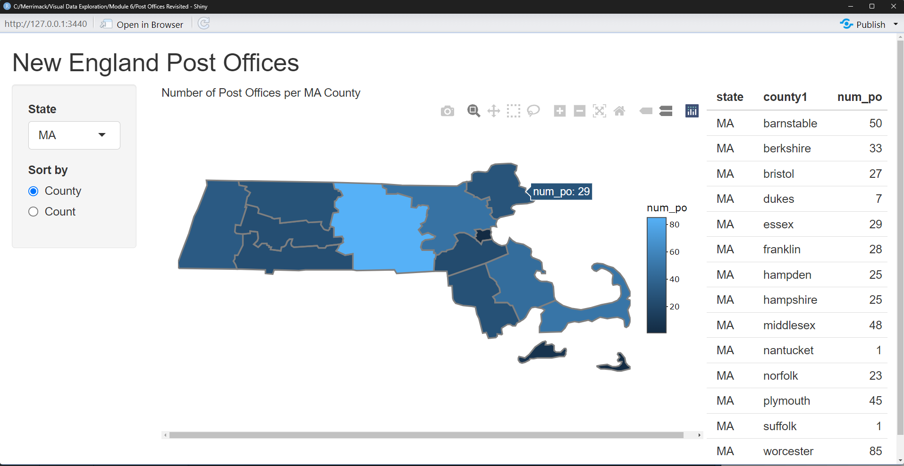
Example: Post Offices (again)
Getting Close to Tableau with Shiny and Plotly

Slide 30
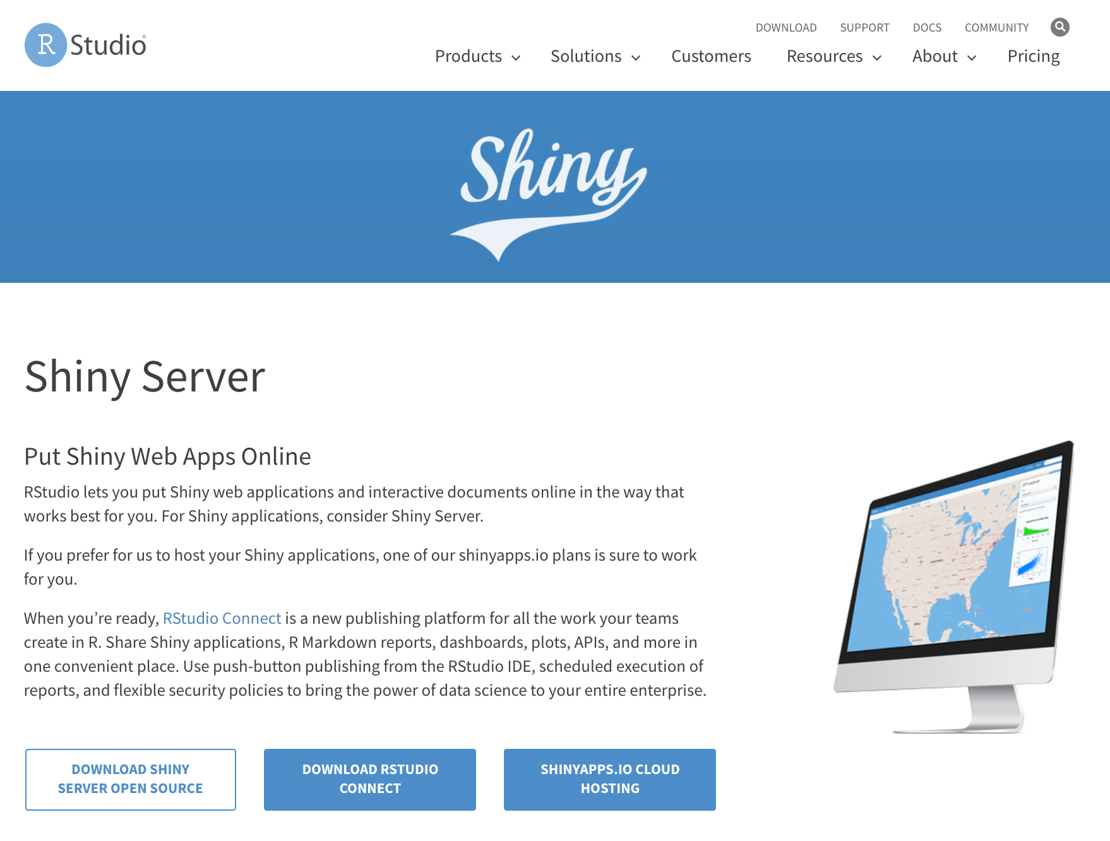
Hosting a Shiny App
Shiny creates a web application, so connection to a server must be available at all times!
Options to host your application:
Run it locally: creates an application accessible at http://localhost:6504 or http://127.0.0.1:6504 (you may have to denote a port number)
Run it in the cloud using shinyapps.io (limited options and not for confidential information)
Run a Shiny Server within your network
13

Slide 31
Shiny Resources
https://mastering-shiny.org/ - a general guide
https://shiny.rstudio.com/gallery/ - a set of examples that you can retool for your project
https://rstudio.github.io/shinydashboard/index.html - a set of extensions to create dashboards in Shiny
Static alternatives in R (flexdashboard)
https://pkgs.rstudio.com/flexdashboard/
https://rstudio.github.io/flexdashboard/articles/examples.html
13

